Slide 1
Saad's Smart Orientation app Breakdown
Part By Part Detailed Breakdown
"Made by Saad Adnane"

Slide 2
design

Slide 3
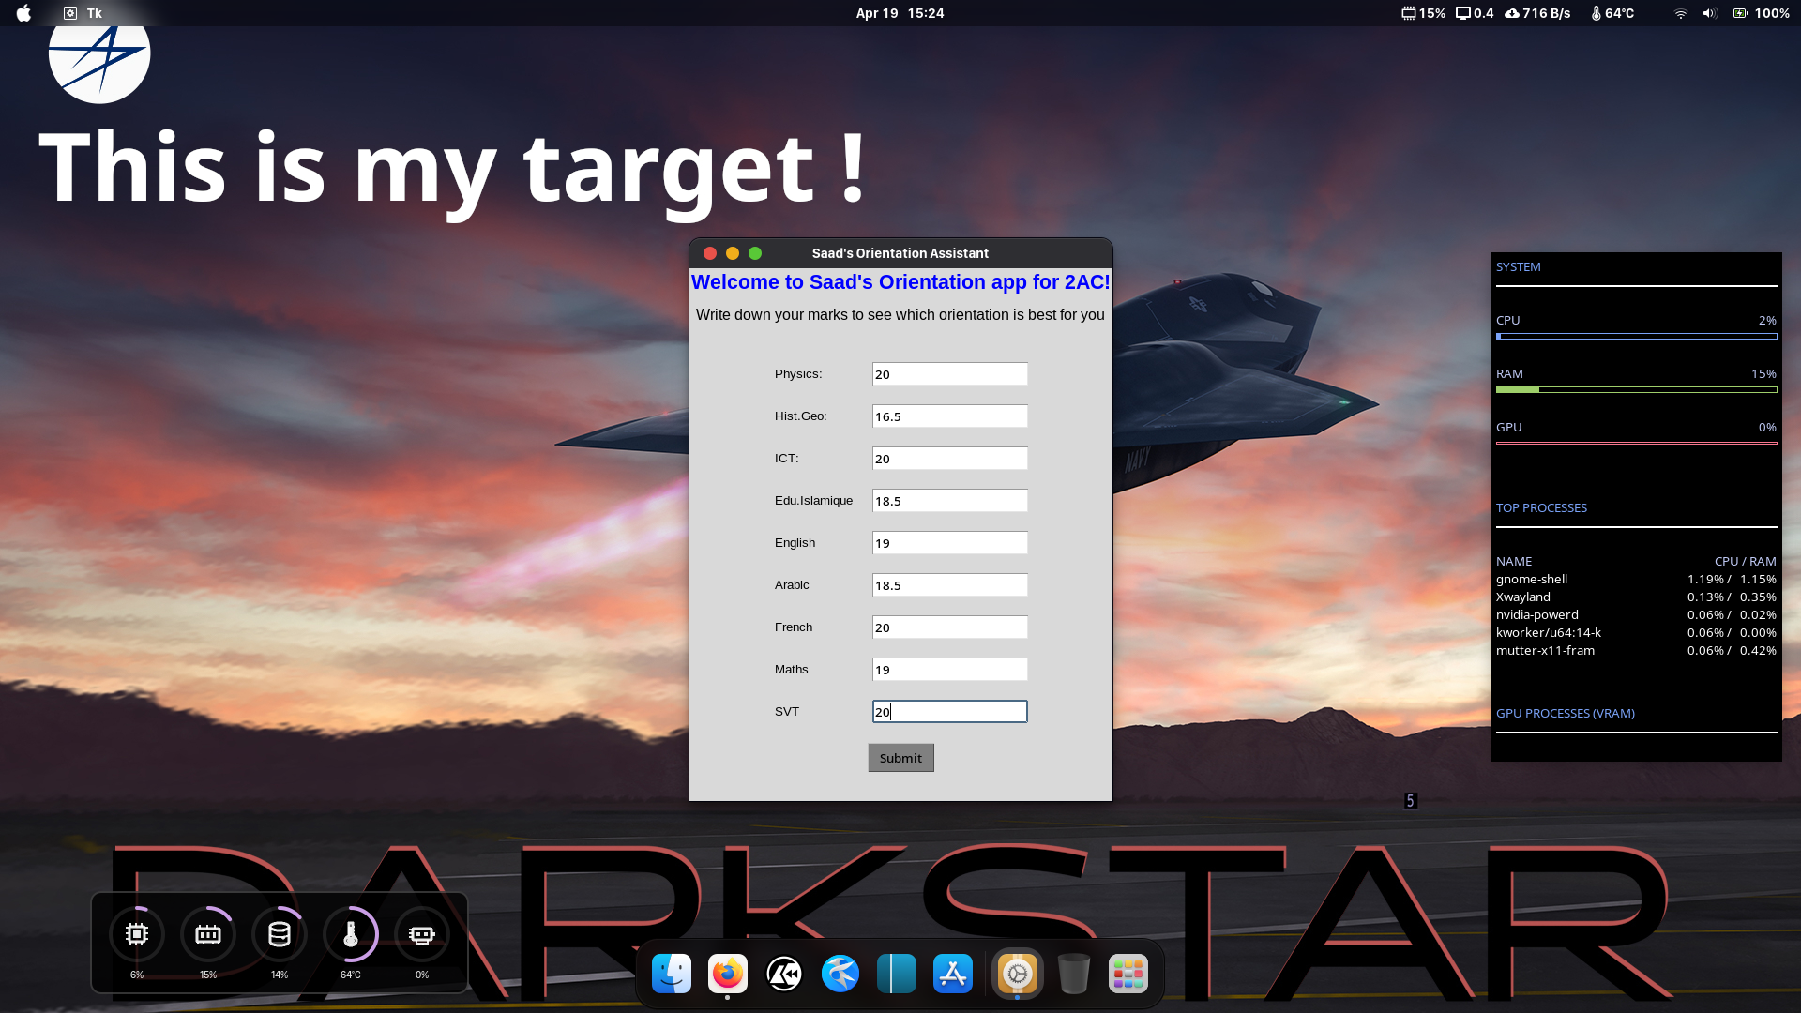
Smart Orientation Assistant app running
{before clicking 'Submit'}
I am working on Linux fedora

Slide 4
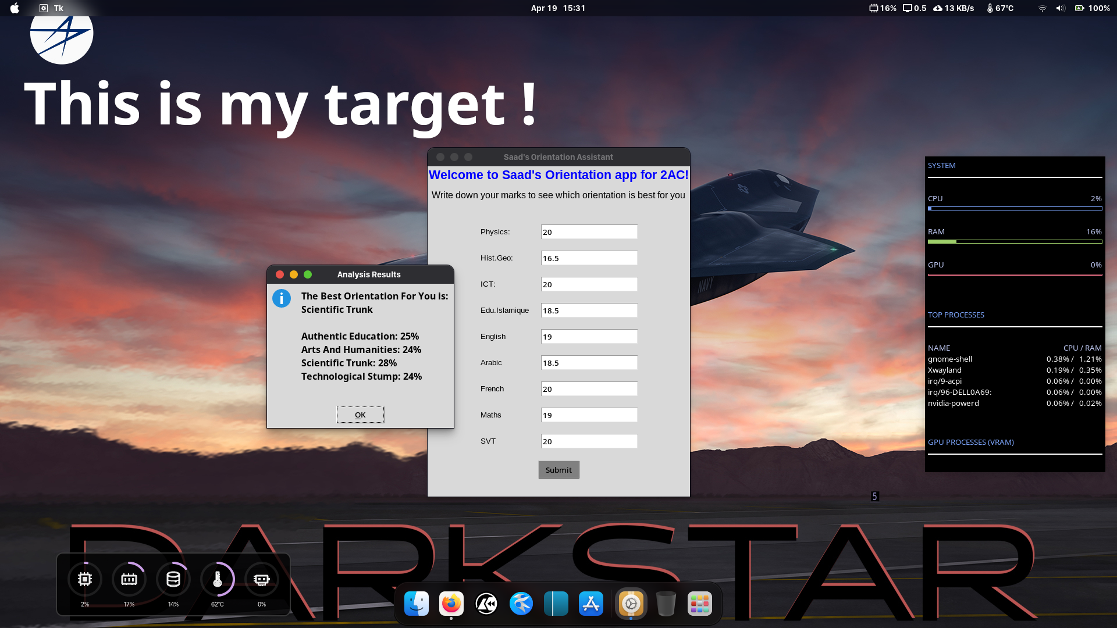
Smart Orientation Assistant app running
{After clicking 'Submit'}

Slide 5
#!/usr/bin/env python3
# coding: utf-8
Upwards I'm just telling your PC to run this as a Python code and this ensures comptability with mac os and linux while running smoothly on windows..
In the second line I'm adding support to imogies, french accents and arabic letters "in case I needed them"
import tkinter as tk
from tkinter import ttk, messagebox
first line is importing a library that I need and aliasing it as tk
And the second I'm importing ttk "Themed tkinter", and this themed tkinter is making it look modern unlike windows 95..
root = tk.Tk()
root.title("Saad's Orientation Assistant")
Creating main frame and title

Slide 6
Downwards I'm creating labels and entries "simply design" and tricking tkinter so I can use ".grid" and ".pack" in the same window
MainLabel1 = tk.Label(root, text = "Welcome to Saad's Orientation app for 2AC!", font=("Arial", 16, "bold") ,foreground="Blue")
MainLabel1.pack()
MainLabel2 = tk.Label(root, text = "Write down your marks to see which orientation is best for you", font=("Arial", 12), pady = 10)
MainLabel2.pack()
Frame = ttk.Frame(root)
Frame.pack(pady = 20)
Label1 = ttk.Label(Frame, text = "Physics:", font = ("Arial", 10))
Label1.grid(row = 1, column = 0, sticky = "w", padx = 10, pady = 10)
Entry1 = ttk.Entry(Frame)
Entry1.grid(row = 1, column = 1, sticky = "w", padx = 10, pady = 10)
Label2 = ttk.Label(Frame, text = "Hist.Geo:", font = ("Arial", 10))
Label2.grid(row = 2, column = 0, sticky = "w", padx = 10, pady = 10)
Entry2 = ttk.Entry(Frame)
Entry2.grid(row = 2, column = 1, sticky = "w", padx = 10, pady = 10)

Slide 7
Label3 = ttk.Label(Frame, text = "ICT:", font = ("Arial", 10))
Label3.grid(row = 3, column = 0, sticky = "w", padx = 10, pady = 10)
Entry3 = ttk.Entry(Frame)
Entry3.grid(row = 3, column = 1, sticky = "w", padx = 10, pady = 10)
Label4 = ttk.Label(Frame, text = "Edu.Islamique", font = ("Arial", 10))
Label4.grid(row = 4, column = 0, sticky = "w", padx = 10, pady = 10)
Entry4 = ttk.Entry(Frame)
Entry4.grid(row = 4, column = 1, sticky = "w", padx = 10, pady = 10)
Label5 = ttk.Label(Frame, text = "English", font = ("Arial", 10))
Label5.grid(row = 5, column = 0, sticky = "w", padx = 10, pady = 10)
Entry5 = ttk.Entry(Frame)
Entry5.grid(row = 5, column = 1, sticky = "w", padx = 10, pady = 10)
Label6 = ttk.Label(Frame, text = "Arabic", font = ("Arial", 10))
Label6.grid(row = 6, column = 0, sticky = "w", padx = 10, pady = 10)
Entry6 = ttk.Entry(Frame)
Entry6.grid(row = 6, column = 1, sticky = "w", padx = 10, pady = 10)

Slide 8
Label7 = ttk.Label(Frame, text = "French", font = ("Arial", 10))
Label7.grid(row = 7, column = 0, sticky = "w", padx = 10, pady = 10)
Entry7 = ttk.Entry(Frame)
Entry7.grid(row = 7, column = 1, sticky = "w", padx = 10, pady = 10)
Label8 = ttk.Label(Frame, text = "Maths", font = ("Arial", 10))
Label8.grid(row = 8, column = 0, sticky = "w", padx = 10, pady = 10)
Entry8 = ttk.Entry(Frame)
Entry8.grid(row = 8, column = 1, sticky = "w", padx = 10, pady = 10)
Label9 = ttk.Label(Frame, text = "SVT", font = ("Arial", 10))
Label9.grid(row = 9, column = 0, sticky = "w", padx = 10, pady = 10)
Entry9 = ttk.Entry(Frame)
Entry9.grid(row = 9, column = 1, sticky = "w", padx = 10, pady = 10)

Slide 9
The Core Of The Program

Slide 10
Saving mechanism; grabs grades and the best orientation and put them in a file called: Orientation_Result.txt
def save_to_file(result, marks):
import os
file_path = os.path.join(
os.path.dirname(os.path.abspath(__file__)),
"Orientation_Result.txt"
)
with open(file_path, "w", encoding="utf-8") as file:
file.write("=== Here Are Your Marks And Your Best Orientation! ===\n")
for subject, value in marks.items():
file.write(f"{subject}: {value}\n")
file.write(f"Best Orientation: {result}\n\n")

Slide 11
Initializing variables and checking that all inputs have numbers after clicking the button
If there is a problem an error will be thrown to the user
def Submit():
global Physics, HistGeo, ICT, EduIslamique, English, Arabic, French, Maths, SVT
try:
Physics = float (Entry1.get())
HistGeo = float (Entry2.get())
ICT = float (Entry3.get())
EduIslamique = float (Entry4.get())
English = float (Entry5.get())
Arabic = float (Entry6.get())
French = float (Entry7.get())
Maths = float (Entry8.get())
SVT = float (Entry9.get())
except ValueError:
messagebox.showerror("Input Error", "Please fill all fields with numbers only.")
return

Slide 12
Have you noticed this part of code?
try:
Some code..
Other code..
except ValueError:
messagebox.showerror("Input Error", "Please fill all fields with numbers only.")
It is looking for user errors, so it displays a pop-up in case the user left one of the inputs empty or wrote letters instead of numbers, you will see it in action on the next slide..

Slide 13
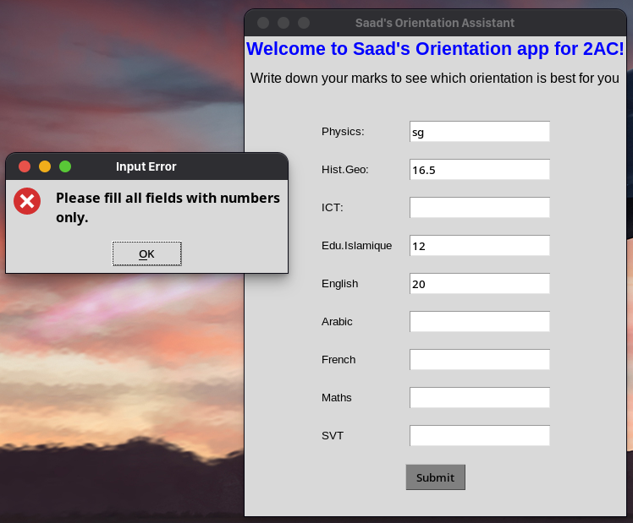
So here, the app caught me not completing all inputs and writing some random letters in others..

Slide 14
Initializing variables holding every orientation's marks "including coefficients", calculating the one with most marks, putting in in a variable called "Best" and calculating total orientations scores "For Percentage" to ensure the recommendations are academically accurate
AuthenticEducation = (Physics * 0) + (HistGeo * 3) + (ICT * 2) + (EduIslamique * 4) + (English * 2) + (Arabic * 4) + (French * 3) + (Maths * 2) + (SVT * 2)
ArtsAndHumanities = (Physics * 0) + (HistGeo * 4) + (ICT * 2) + (EduIslamique * 0) + (English * 3) + (Arabic * 4) + (French * 4) + (Maths * 2) + (SVT * 2)
ScientificTrunk = (Physics * 4) + (HistGeo * 2) + (ICT * 2) + (EduIslamique * 0) + (English * 3) + (Arabic * 2) + (French * 3) + (Maths * 4) + (SVT * 4)
TechnologicalStump = (Physics * 4) + (HistGeo * 2) + (ICT * 3) + (EduIslamique * 0) + (English * 3) + (Arabic * 2) + (French * 3) + (Maths * 4) + (SVT * 0)
Best = max(AuthenticEducation, ArtsAndHumanities, ScientificTrunk, TechnologicalStump)
TotalScore = AuthenticEducation + ArtsAndHumanities + ScientificTrunk + TechnologicalStump

Slide 15
Here, we are initializing four variables to carry the percentages..
AuthenticEducationPercent = (AuthenticEducation / TotalScore) * 100
ArtsAndHumanitiesPercent = (ArtsAndHumanities / TotalScore) * 100
ScientificTrunkPercent = (ScientificTrunk / TotalScore) * 100
TechnologicalStumpPercent = (TechnologicalStump / TotalScore) * 100

Slide 16
Here, we are doing some "if" statements to see if the user gave a mark bigger than
"20" or less than "0" which is impossible "it should be a typo", so if he did, we will give
him a pop-up, we will se it in action next slide..
if (Physics > 20 or Physics < 0):
messagebox.showerror("Input Error", "Please put values between 0 and 20")
elif (HistGeo > 20 or HistGeo < 0):
messagebox.showerror("Input Error", "Please put values between 0 and 20")
elif (ICT > 20 or ICT < 0):
messagebox.showerror("Input Error", "Please put values between 0 and 20")
elif (EduIslamique > 20 or EduIslamique < 0):
messagebox.showerror("Input Error", "Please put values between 0 and 20")
elif (English > 20 or English < 0):
messagebox.showerror("Input Error", "Please put values between 0 and 20")
elif (Arabic > 20 or Arabic < 0):
messagebox.showerror("Input Error", "Please put values between 0 and 20")
elif (French > 20 or French < 0):
messagebox.showerror("Input Error", "Please put values between 0 and 20")
elif (Maths > 20 or Maths < 0):
messagebox.showerror("Input Error", "Please put values between 0 and 20")
elif (SVT > 20 or SVT < 0):
messagebox.showerror("Input Error", "Please put values between 0 and 20")

Slide 17
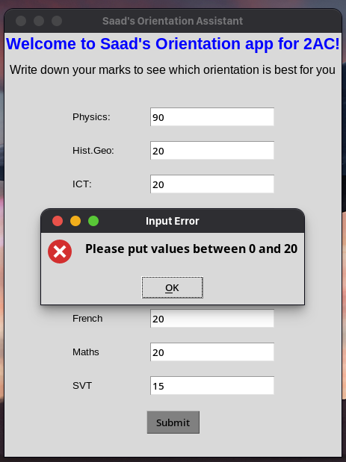

Below I wrote in physics a value that is less than zero
My Smart Orientation Assistant app is also smart in terms of Error-Handling!
Below I wrote in physics a value that is bigger than zero

Slide 18
Outputing to the user based on the best Orientation
if (Best == AuthenticEducation):
best_orientation = "Authentic Education"
elif(Best == ArtsAndHumanities):
best_orientation = "Arts And Humanities"
elif(Best == ScientificTrunk):
best_orientation = "Scientific Trunk"
elif(Best == TechnologicalStump):
best_orientation = "Technological Stump"
messagebox.showinfo(
"Analysis Results",
f"The Best Orientation For You is: {best_orientation}\n\n"
f"Authentic Education: {AuthenticEducationPercent:.0f}%\n"
f"Arts And Humanities: {ArtsAndHumanitiesPercent:.0f}%\n"
f"Scientific Trunk: {ScientificTrunkPercent:.0f}%\n"
f"Technological Stump: {TechnologicalStumpPercent:.0f}%\n"
)

Slide 19
Creating a variable of type "dictionary" to store the name of subject plus its value "the mark you typed" Permanently on your PC!! + we will see a screenshot of the saved .txt file..
marks = {
"Physics": Physics,
"Hist.Geo": HistGeo,
"ICT": ICT,
"Edu.Islamique": EduIslamique,
"English": English,
"Arabic": Arabic,
"French": French,
"Maths": Maths,
"SVT": SVT
}
Calling the function we set in Slide 11
save_to_file(best_orientation, marks)

Slide 20
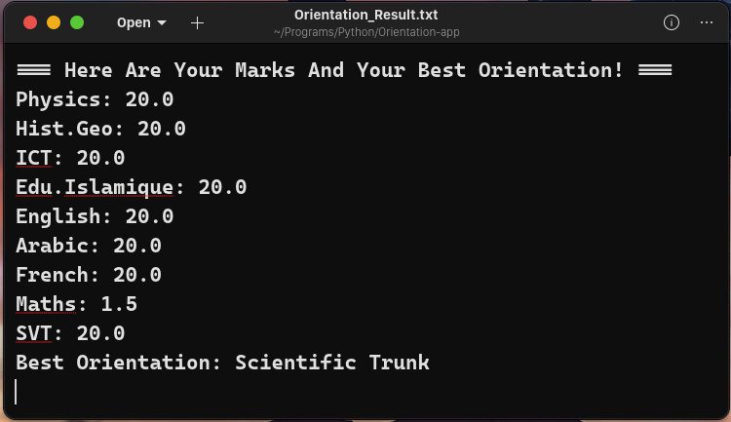
The file generated by the Smart Orientation Assistant app
{This file is created once the user clicks 'submit'}
{It is stored on the same directory as the main program}
{If the user updates the marks, then he clicked 'Submit' again, the marks will be added into the same file}
The app provides more than a pop-up. It generates a permanent, UTF-8 encoded record of the student's marks and the best orientation path, this makes it a tool that can be shared with parents or teachers!

Slide 21
Creating a "Submit" button
SubmitButton = tk.Button(Frame, text = "Submit", bg = "gray", command = Submit)
SubmitButton.grid(row = 10, column = 0, columnspan = 2, pady = 10)
Keeping the app running over and over until the user exits
root.mainloop()

Slide 22
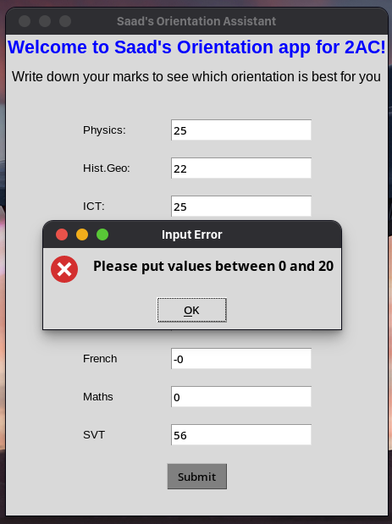
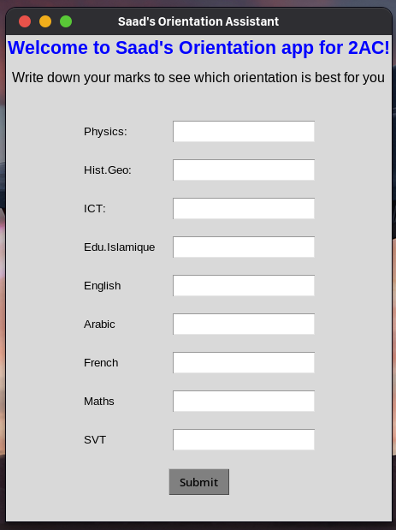
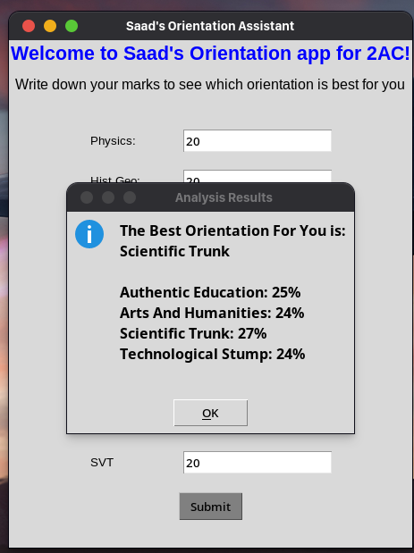
This tool bridges the gap between raw data and a student's future. It is not just a script; it is a
Smart Orientation Assistant !!

